Slide 1
SSD: Single Shot MultiBox Detector

Slide 2
abstract

Slide 3
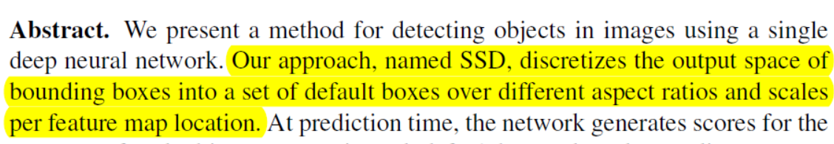
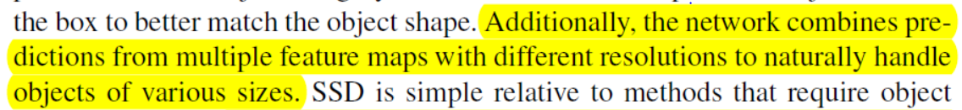
Abstract
SSD는 각 feature map마다 다른 aspect ratios와 scale을 갖는 default box가 나오는 공간을 분할하는 접근을 하고 있음
그 네트워크는 다양한 feature maps의 prediction을 합친다.
?????????????????

Slide 4
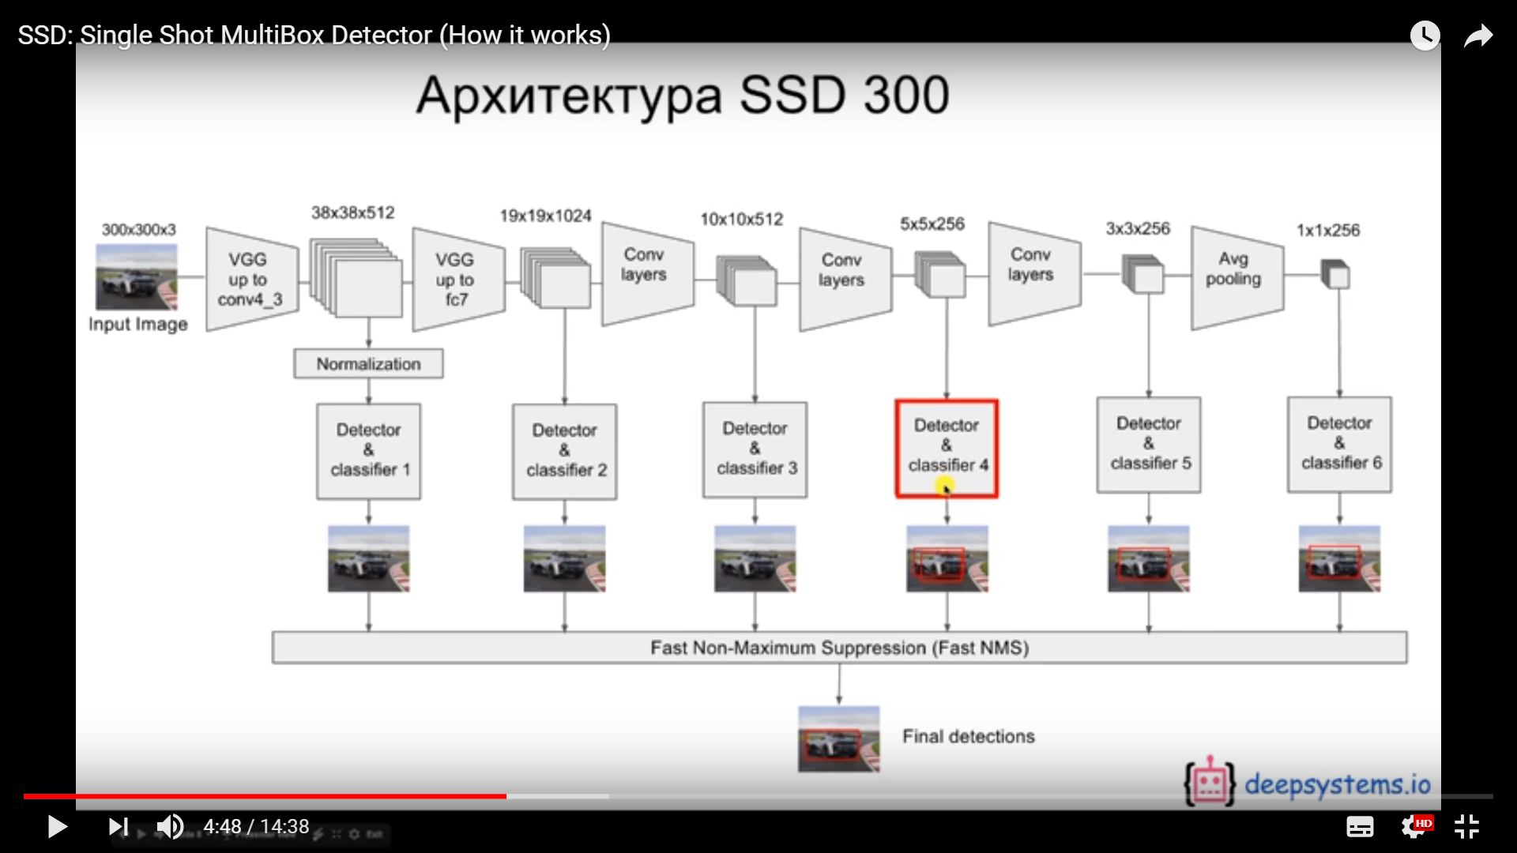
https://www.youtube.com/watch?v=P8e-G-Mhx4k
Feature map size를 줄여가면서
매 feature map 마다 output box를 냄
그 output box들을 NMS로 취합

Slide 5
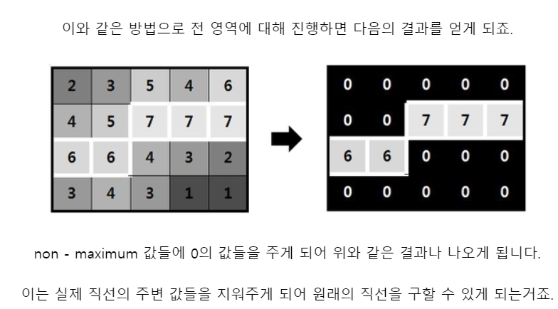
Non-Maximum Supression
원래 blur 되어 있는 선을 선명하게 할 때 사용
Max 값만 남기고 나머지는 0으로 치환
출처 :https://m.blog.naver.com/PostView.nhn?blogId=jinsoo91zz&logNo=220511441402&proxyReferer=https%3A%2F%2Fwww.google.co.kr%2F

Slide 6
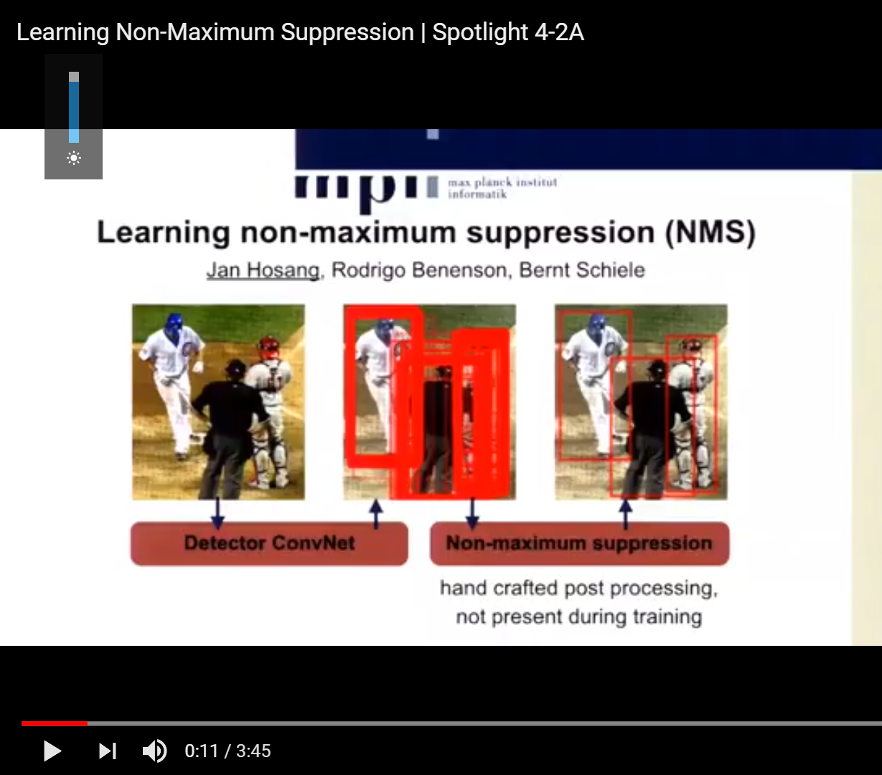
Non-Maximum Supression
Output으로 나온 box들을
NMS를 하면
하나로 정리돼서 나옴
출처 https://www.youtube.com/watch?v=SnYMimFnKuY

Slide 7
https://www.youtube.com/watch?v=P8e-G-Mhx4k
각 feature map에서
어떻게 output box를 내는지 자세히 보면

Slide 8
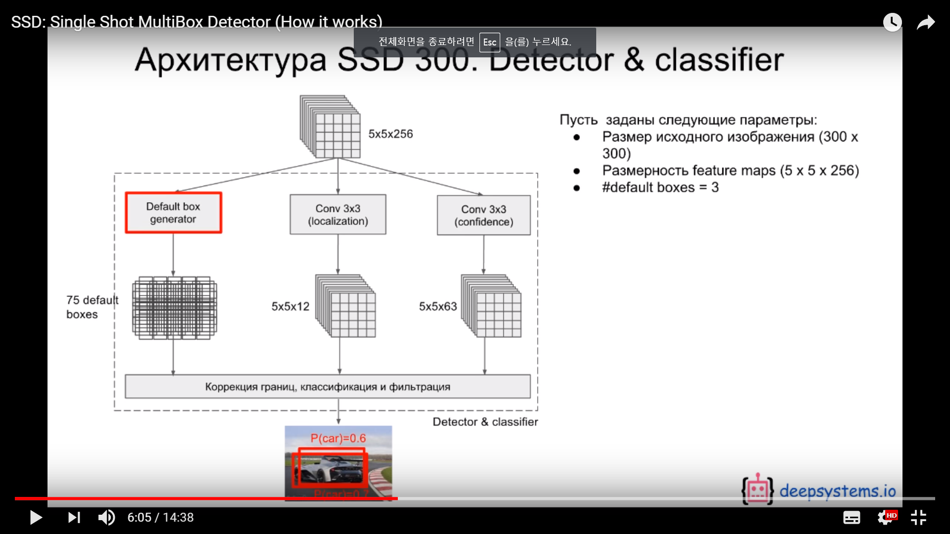
https://www.youtube.com/watch?v=P8e-G-Mhx4k
Default box 들을 만들어 놓은 다음
Localization 결과값과
Confidence 결과값으로 조정을 통해
그 feature map의 최종 output box를 내게 됨

Slide 9
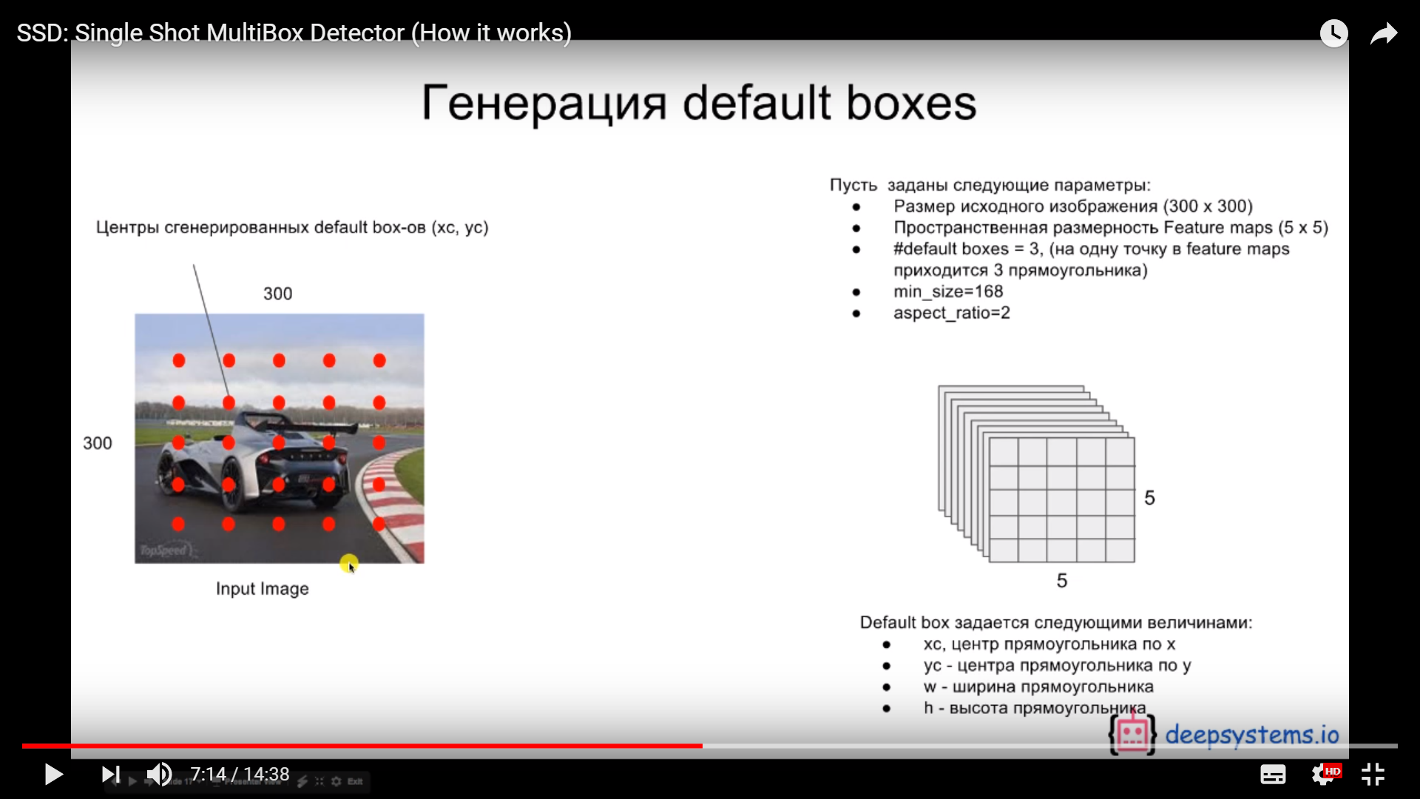
https://www.youtube.com/watch?v=P8e-G-Mhx4k
어떻게 default box들은 만들어지느냐?
이미지에서 box가 나올 수 있는 공간을 나눔
Discretizes the output space of bounding boxes

Slide 10
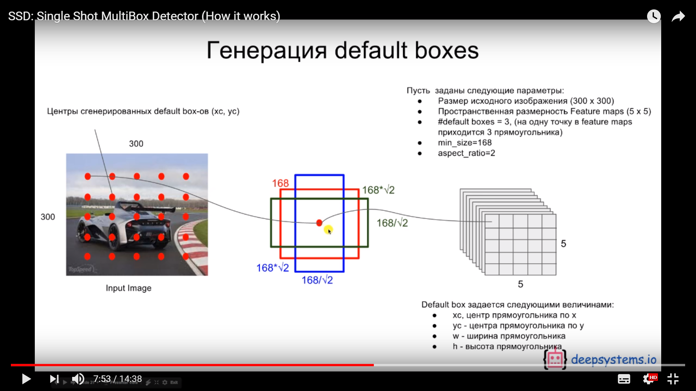
https://www.youtube.com/watch?v=P8e-G-Mhx4k
Box가 나오는 각 포인트에서
다양한 scale의 box를 생성함
A set of default boxes over different aspect ratios and scales

Slide 11
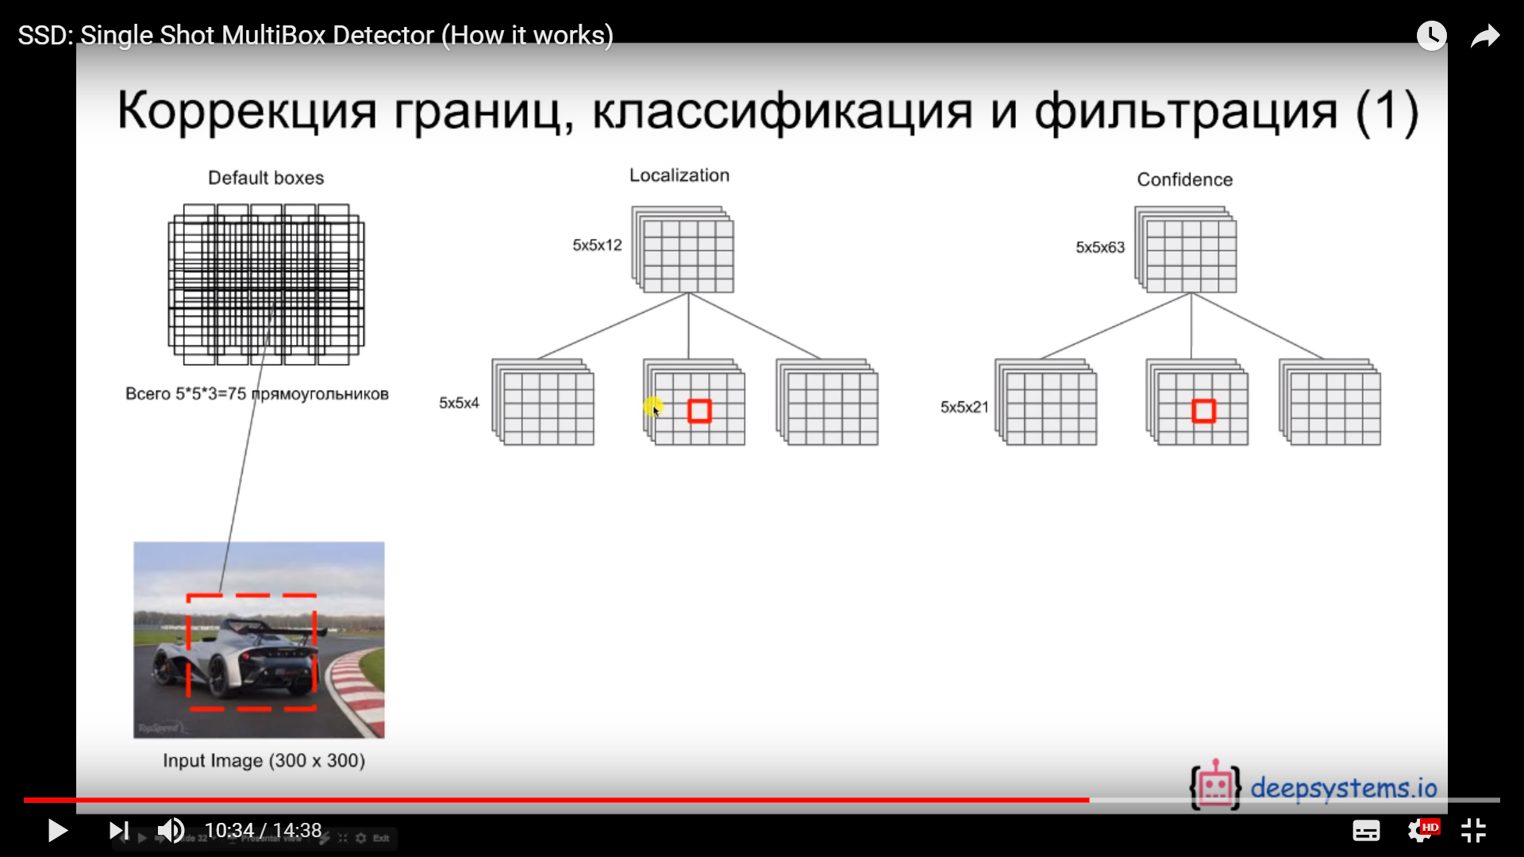
https://www.youtube.com/watch?v=P8e-G-Mhx4k
이렇게 생성된
Box는

Slide 12
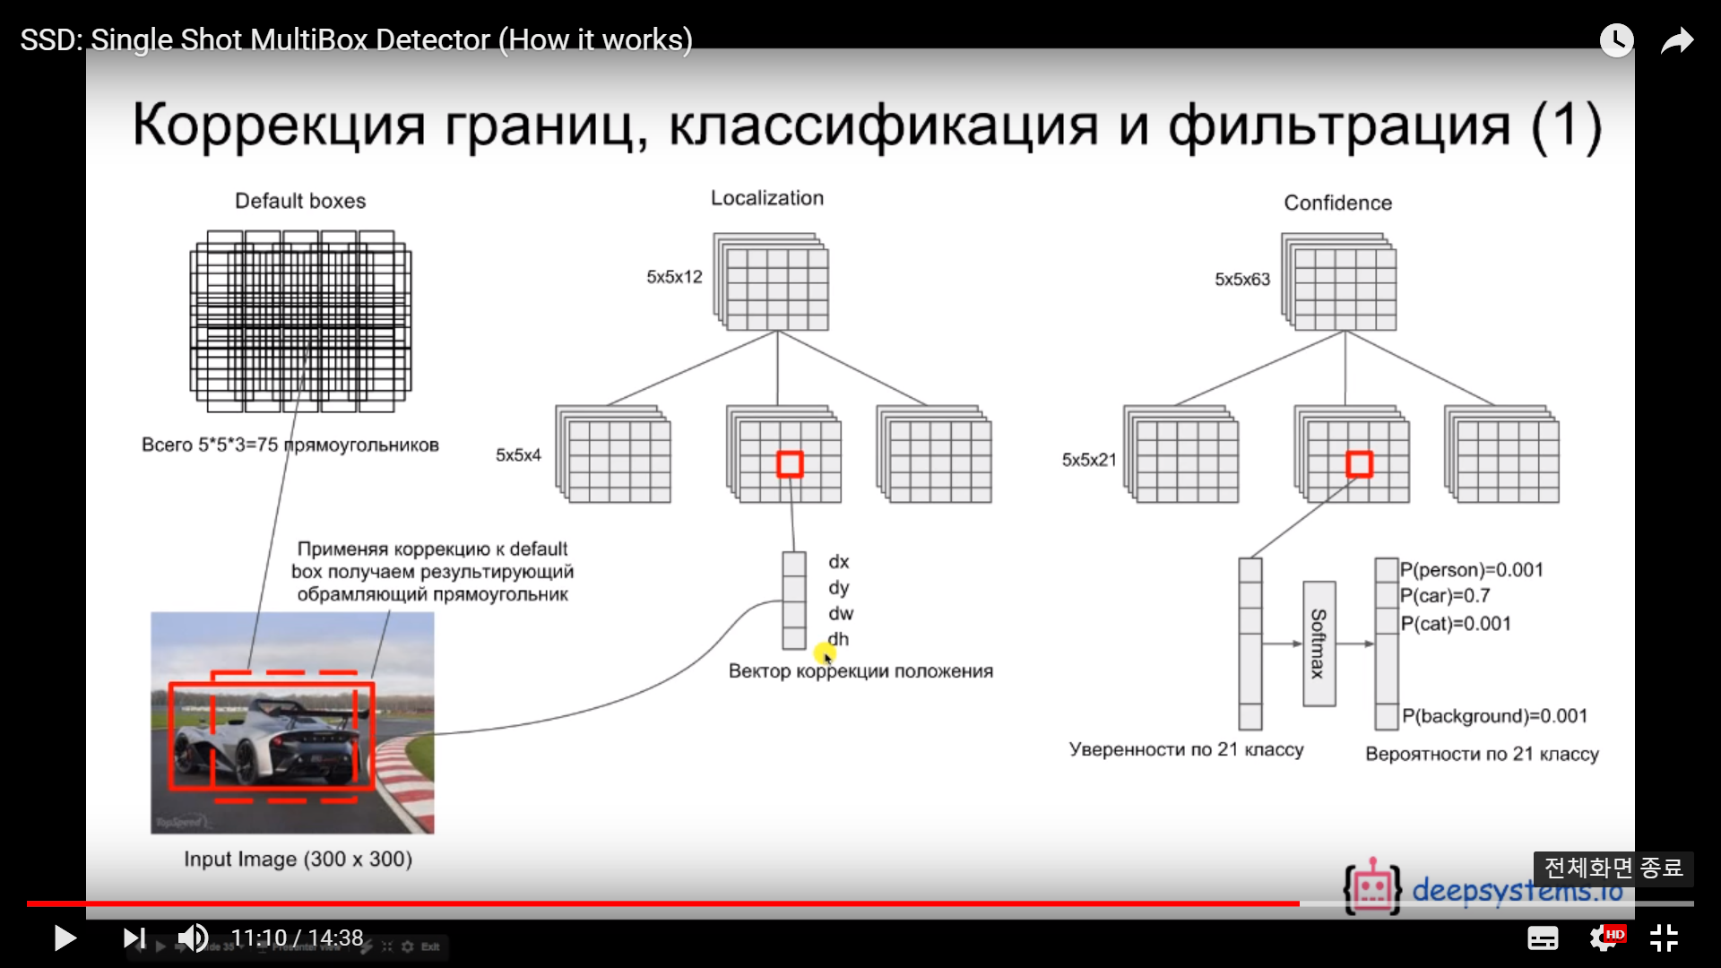
https://www.youtube.com/watch?v=P8e-G-Mhx4k
Localization loss에 의해
조정됨

Slide 13
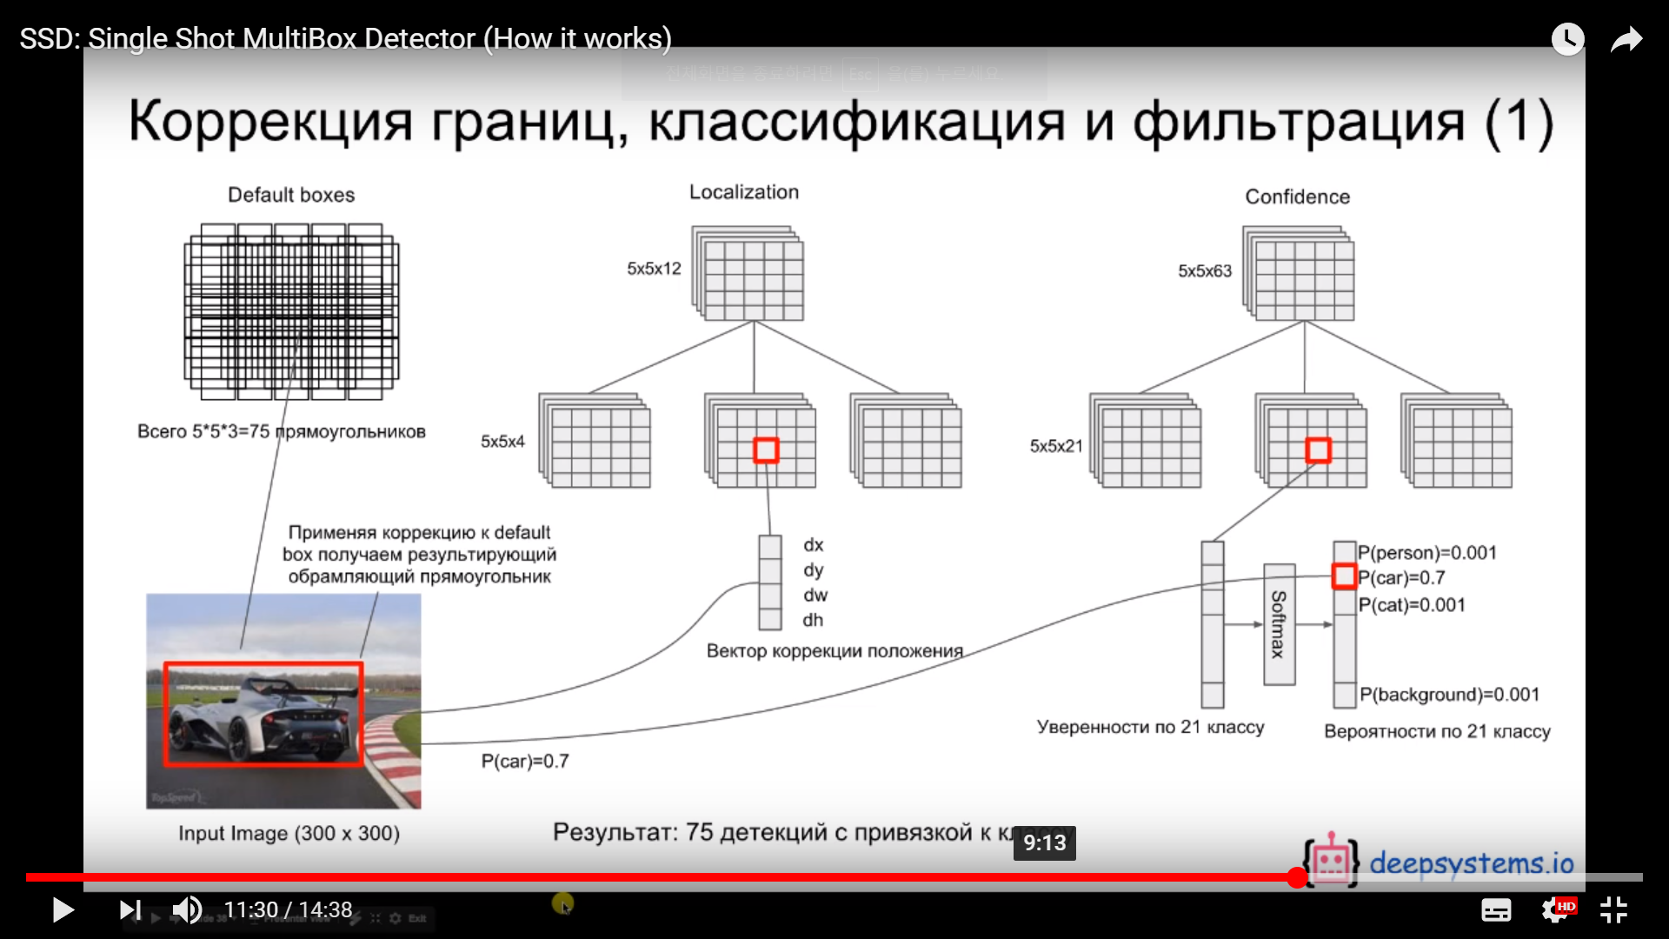
https://www.youtube.com/watch?v=P8e-G-Mhx4k
Localization loss에 의해
조정됨
Confidence loss에
class에 할당됨

Slide 14
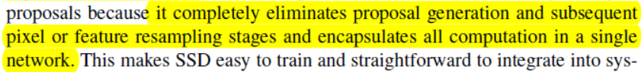
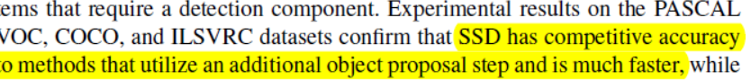
Abstract
이 방법으로 region proposal 생성 및 이하 과정을 없앴음
그래서 RPN을 쓰는 알고리즘의 accuracy가 나오면서도 더 빠르다

Slide 15
introduction

Slide 16
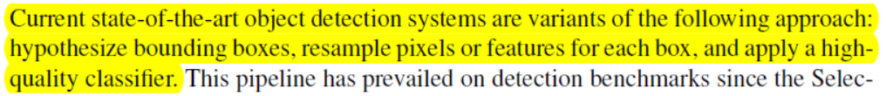
Introduction
최근 object detection 계에서는 bounding box 구하고 각 박스마다 pixel을 resample 거기에 classifier를 적용하는 방법이 유행
그러나 그 방법은 고성능 컴퓨터가 필요하고, 느림
그래서 속도를 올리려는 많은 시도가 있었는데,
속도가 올라가면 정확도가 낮아지는 현상이 발생

Slide 17
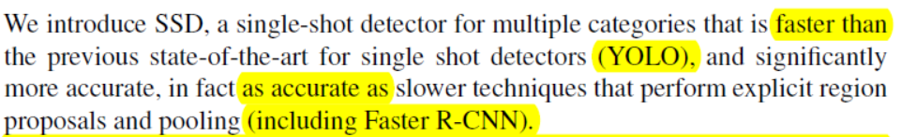
Introduction
우리는 앞에서 설명한 방법을 써서
욜로보다 빠르면서도 faster R-CNN의 정확도를 확보했다.

Slide 18
model

Slide 19
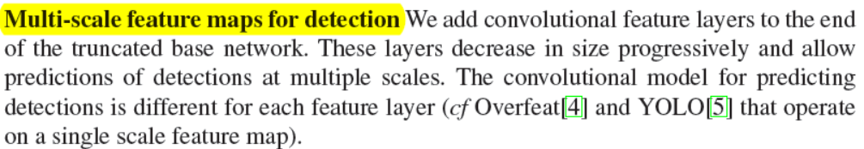
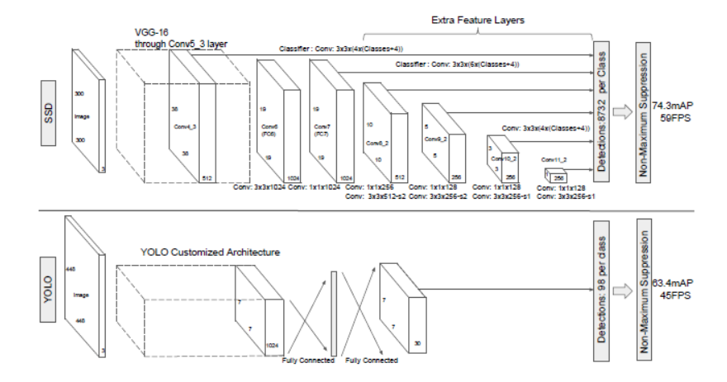
model
Multi-scale feature map을 사용
이를 통해 low resolution input에서도 high-accuracy를 달성

Slide 20
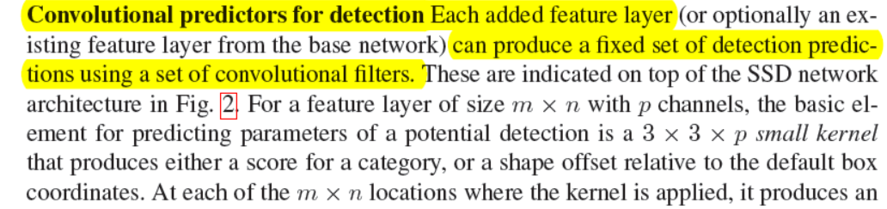
model
각 feature layer에 작은 convolution filter set을 사용

Slide 21
https://www.youtube.com/watch?v=P8e-G-Mhx4k
Conv 3x3 filter

Slide 22
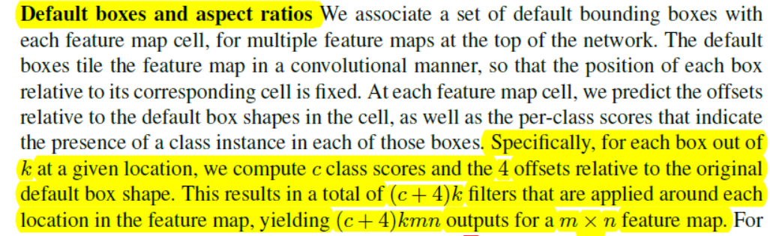
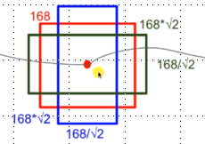
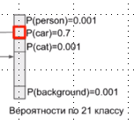
model
m x n feature map에서 나오는Default box :
‘Given location k’ * (‘class 수 c’ + ‘original default box shape 4’) * m * n
* (
+
X, y, w, h
)
* m* n
k
c
4

Slide 23
train

Slide 24
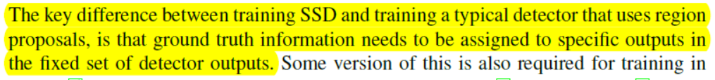
train
SSD가 region proposal model과 다른 점은 ground truth를 detector output의 고정된 set의 output에 할당할 때만 사용한다는 것?
Hard negative mining과 data augmentation 전략을 써서
Set of default boxes과 scale을 선택

Slide 25
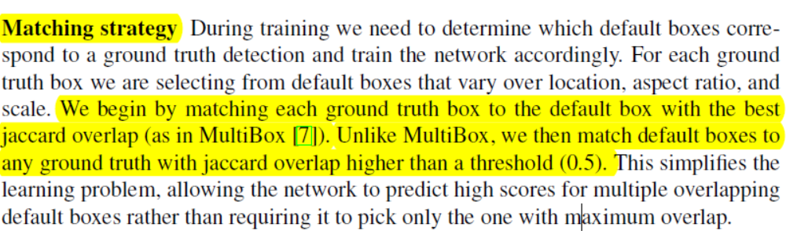
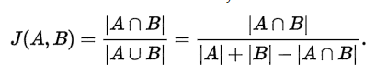
train
우리는 default box와 ground truth box를 매칭할 때
Jaccard overlap 결과가 0.5 이상이면 1이라고 매칭함
Jaccard overlap
교집합 / 합집합

Slide 26
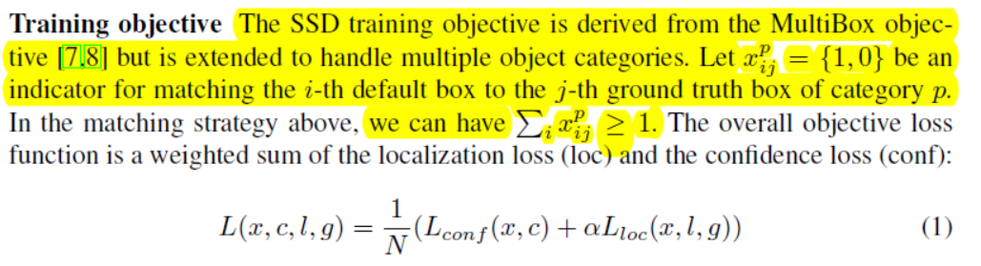
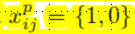
train
i번째 default box와 p 카테고리의j번째 ground truth box가 매칭되면 1, 아니면 0
Object function은 confidence function과 location function의 합으로 구성
N은 매치된 default box 수임, N=0이면 loss는 0

Slide 27
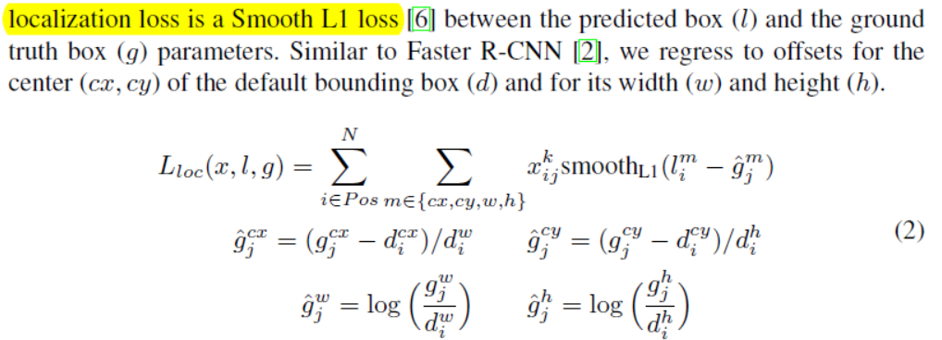
train
Localization loss는 Smooth L1 loss를 사용함
이 것은 Faster R-CNN에서의 loss와 유사

Slide 28
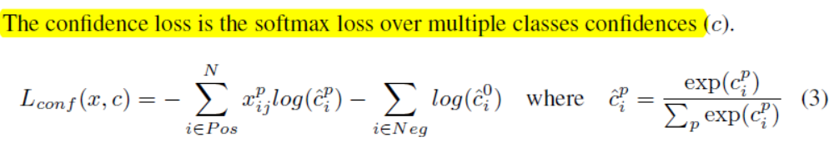
train
Postive 중 p카테고리 box가
p 카테고리에 들어갈 확률
Negative 에서 배경일 확률
Softmax를 써서 confidenece loss 계산

Slide 29
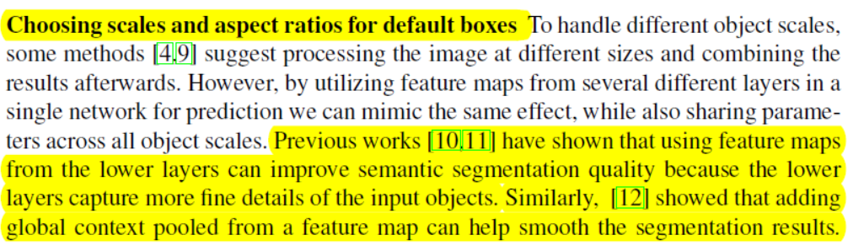
train
이전 연구에서 lower layer의 feature map은 더 세세한 디테일을 잡아내서 Semantic segmentation 품질을 높이고
.
더 높은 layer의 feature map은 global context를 잡아내서 segmentation results를 스무딩하는 효과를 냈다.
그래서 우리는 둘 다 씀

Slide 30
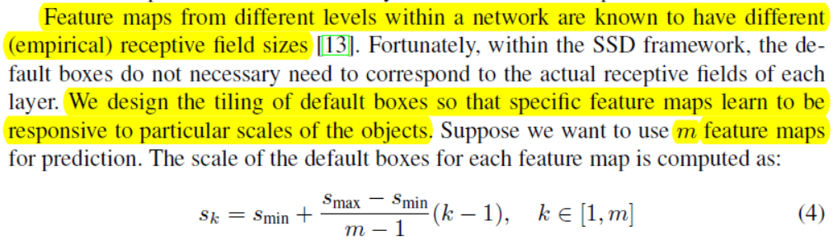
train
한 네트워크에서 다른 레벨의 featur맵은 다른 receptive filed size를 갖는 것으로 알려짐
그래서 우리는 default box을 특정 feature map이 특정 object의 scale에 반응하도록 배우게 했다

Slide 31
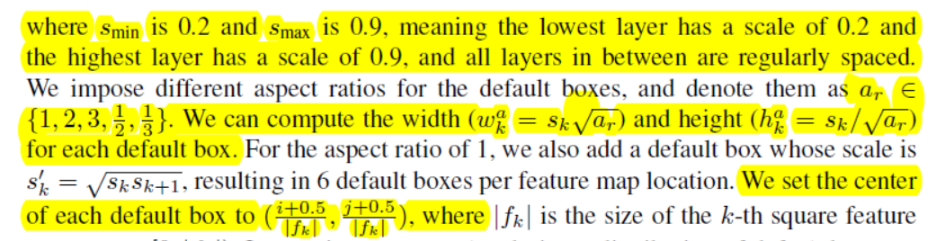
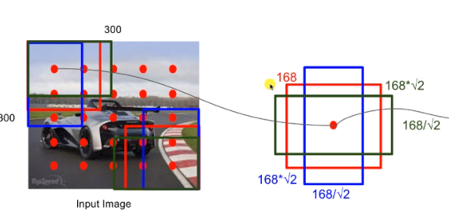
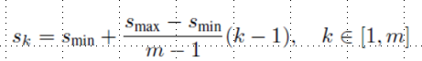
train

Slide 32
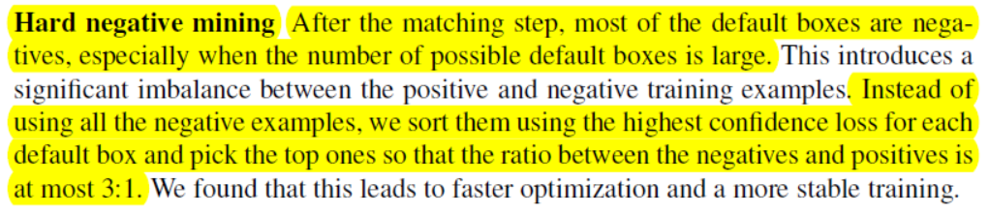
train
Negative sample이 많기 때문에
Confidence loss가 높은 애들만 모아서
# Negative box : # Positive box = 3 : 1이 되게 함

Slide 33
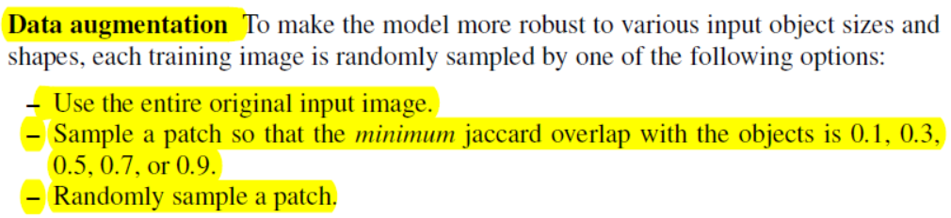
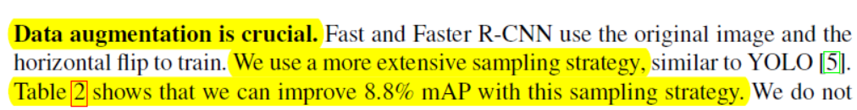
train
Jaccard overlap에 따라 input image patch를 만듦
이 것을 random sampling
성능 향상에 매우 큰 기여를 했다(안 했을 때 대비 8.8% mAP 향상)

Slide 34
SSD: Single Shot MultiBox Detector 2

Slide 35
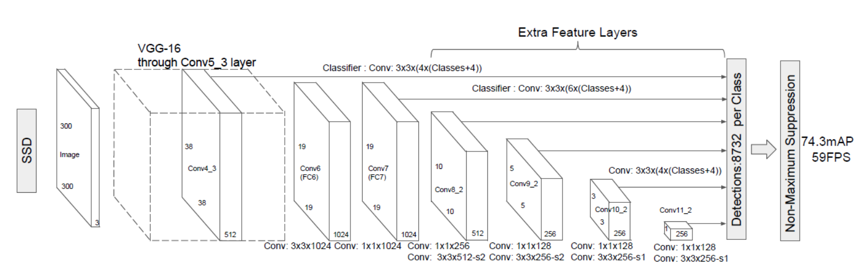
The Single Shot Detector (SSD) – 2.1 Model
Multi-scale feature maps for detection
These layers decrease in size progressively and allow predictions of detections at multiple scales

Slide 36
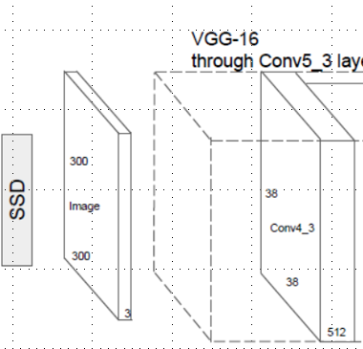
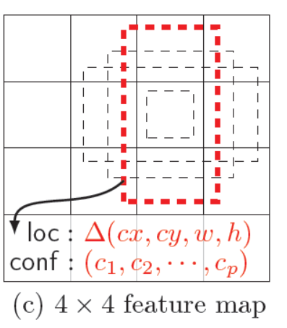
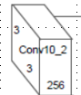
The Single Shot Detector (SSD) – 2.1 Model
Convolutional predictors for detection
For a feature layer of size m x n with p channels, the basic element for predicting parameters of a potential detection is a 3 x 3 x p small kernel that produces either a score for a category, or a shape offset relative to the default box coordinates.
At each of the m x n locations where the kernel is applied, it produces an output vale
…..
4
4
38 x 38 x 512
Feature map
4 x 4 x ??
Feature map
Feature map Size 만큼 location이 생기고
각 location 마다 output value가 나옴

Slide 37
The Single Shot Detector (SSD) – 2.1 Model
Default boxes and aspect ratios
At each feature map cell, we predict the offsets relative to the default box shapes in the cell, as well as the per-class scores that indicate the presence of a class instance in each of those boxes.
For each box out of k at a given location, we compute c class scores and the 4 offsets relative to the original default box shape. This results in a total of (c+4)k filters that are applied around each location in the feature map, yielding (c + 4)kmn outputs for a m x n feature map
k
(c + 4)kmn
Class score,
Class 만큼 나옴
(cx, cy, w, h)
c
(cx, cy, w, h)
Box 수
locations

Slide 38
The Single Shot Detector (SSD) – 2.2 Training
Matching strategy
For each ground truth box we are selecting from default boxes that vary over location, aspect ratio, and scale
…
Unlike MultiBox, we then match default boxes to any ground truth with jaccard overlap higher than a threshold (0.5)
Jaccard overlap
Jaccard overlap이 0.5 이상이면
Mached default box로 본다
(positive negative는 mached default box 중에서 결정,
match되지 않은 box는 버림)

Slide 39
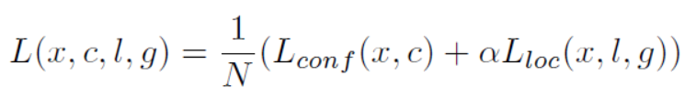
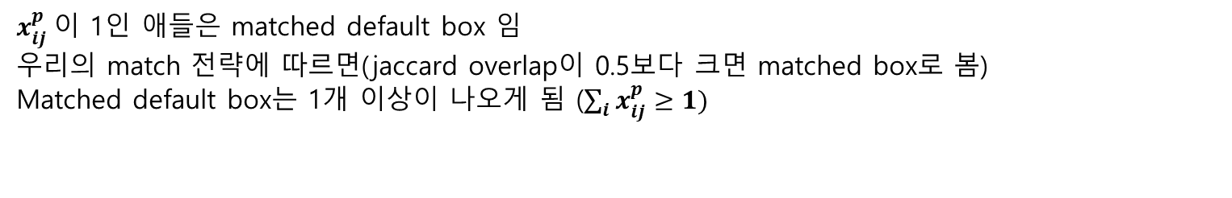
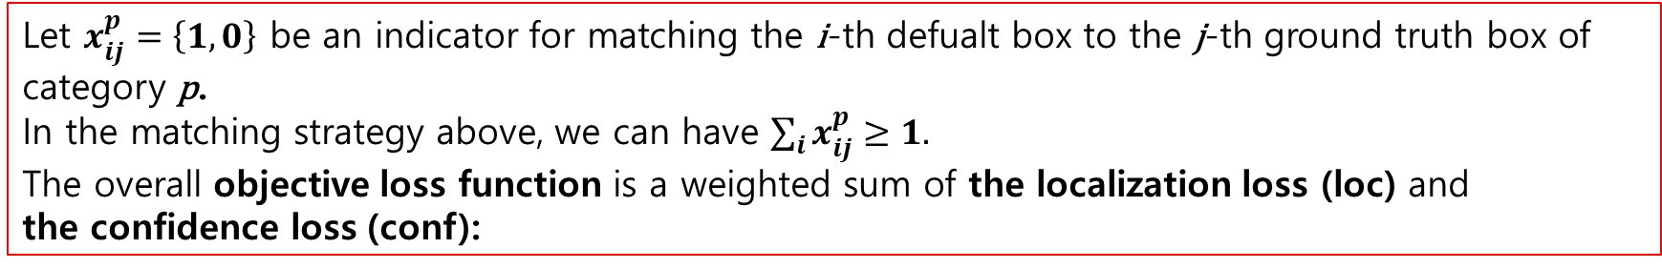
The Single Shot Detector (SSD) – 2.2 Training
Training objective
Let $x_{ij}^{p}=\left\{1,0\right\}$ be an indicator for matching the i-th defualt box to the j-th ground truth box of category p.
In the matching strategy above, we can have $\sum_{i}{x_{ij}^{p}}≥1.$
The overall objective loss function is a weighted sum of the localization loss (loc) and
the confidence loss (conf):
$x_{ij}^{p}$이 1인 애들은 matched default box 임
우리의 match 전략에 따르면(jaccard overlap이 0.5보다 크면 matched box로 봄)
Matched default box는 1개 이상이 나오게 됨 ($\sum_{i}{x_{ij}^{p}}≥1)$
input
ground
truth
box
N은
match된
default box 수
classes
confidences
predicted box

Slide 40
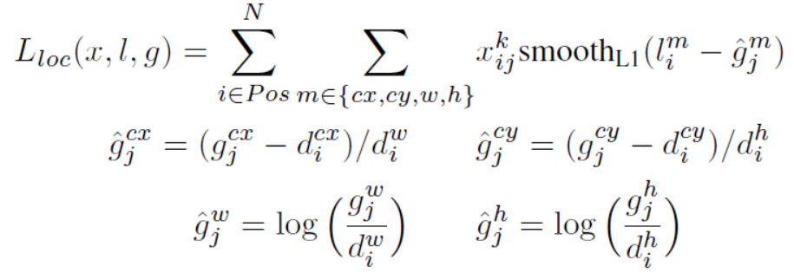
The Single Shot Detector (SSD) – 2.2 Training
Training objective
Where N is the number of matched default boxes. If N = 0, wet set the loss to 0. The localization loss is a Smooth L1 loss [6] between the predicted box (l) and the ground truth box (g) parameters. Similar to Faster R-CNN [2], we regress to offsets for the center (cx, cy) of the default bounding box (d) and for its width (w) and height (h).
predicted box의
{cx, cy, w, h}
ground truth box의
{cx, cy, w, h}
feature map마다
ground truth 비율이
바뀌니까,
그때 그때의
default box 크기로
나눠주어
조정해준 것 같음….

Slide 41
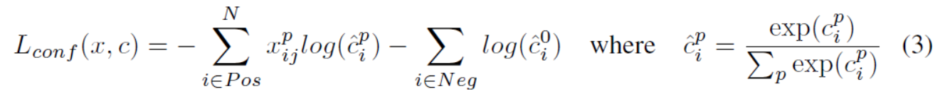
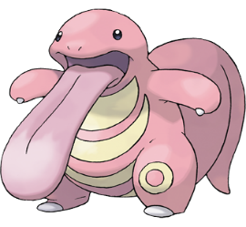
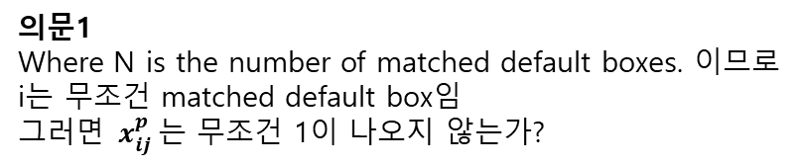
The Single Shot Detector (SSD) – 2.2 Training
Training objective
The confidence loss is the softmax loss over multiple classes confidences (c).
의문1
Where N is the number of matched default boxes. 이므로
i는 무조건 matched default box임
$그러면 x_{ij}^{p}$는 무조건 1이 나오지 않는가?
의문2
그럼 positive, Negative 나누는 기준은??
POS | 버림
NEG | 버림
Jaccard overlap이
0.5 미만이므로

Slide 42
The Single Shot Detector (SSD) – 2.2 Training
Choosing scales and aspect ratios for default boxes
To handle different object scales, some methods [4, 9] suggest processing the image at different sizes and combining the results afterwards
However, by utilizing feature maps from several different layers in a single network for prediction we can mimic the same effect, while also sharing parameters across all object scales
오브젝트의 각기 다른 크기를 다루기 위해, 몇몇 모델을 이미지 크기를 조정해서 나중에 넣는 방법을 사용하지만
우리의 방법은 한 네트워크에 다른 몇몇의 레이어의 feature map을 이용해서 이 것을 해결,
우리의 방법은 효과도 똑같으면서 parameter까지 공유한다
Feature maps from different levels within a network are known to have different(empirical) receptive field sizes. Fortunately, within the SSD Framework, the default boxes do not necessary need to correspond to the actual receptive fields of each layer.
We design the tiling of default boxes so that specific feature maps learn to be responsive to particular scales of the objects.
SSD Framesork에서 default boxes는 각 레이어의 실제 receptive field와 대응될 필요는 없다.
우리는 default box를 타일링 해, 득정 feature map이 특정 오브젝트의 크기에 대해 학습하도록 했다.

Slide 43
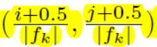
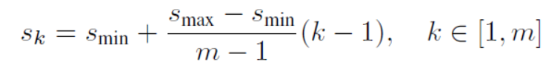
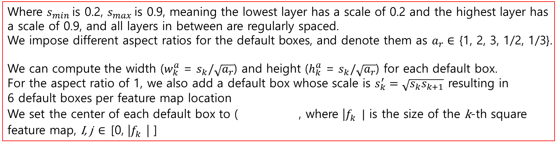
The Single Shot Detector (SSD) – 2.2 Training
Choosing scales and aspect ratios for default boxes
Where $s_{min}$is 0.2, $s_{max}$is 0.9, meaning the lowest layer has a scale of 0.2 and the highest layer has a scale of 0.9, and all layers in between are regularly spaced. We impose different aspect ratios for the default boxes, and denote them as $a_{r}∈$ {1, 2, 3, 1/2, 1/3}.
We can compute the width ($w_{k}^{a}$ = $s_{k}/\sqrt{a_{r}}$) and height ($h_{k}^{a}$ = $s_{k}/\sqrt{a_{r}}$) for each default box.
For the aspect ratio of 1, we also add a default box whose scale is $s_{k}^{′}=\sqrt{s_{k}s_{k+1}}$ resulting in 6 default boxes per feature map location
We set the center of each default box to ( , where |$f_{k}^{}|$ is the size of the k-th square feature map, I, j $∈$ [0, |$f_{k}^{}$| ]
$s_{min}$ 이 0.2, $s_{max} 이$ 0.9는 가장 하위 레이어의 scale이 0.2, 가장 상위 레이어의 scale이 0.9라는 것을 뜻함

Slide 44
The Single Shot Detector (SSD) – 2.2 Training
Hard negative mining
After training step, most of the default boxes are negatives, especially when the number of possible default boxes is large.
…
Instead of using all the negative examples, we sort them using the highest confidence loss for each default box and pick the top ones so that the ratio between the negatives and postives is at most 3:1
negative box가 너무 많이 나오니, confidence loss가 큰 것 순으로 sort 후 positives : negatives = 1 : 3으로 조정

Slide 45
The Single Shot Detector (SSD) – 2.2 Training
Data augmentation
- Use the entire original input image
- Sample a patch so that the minimum jaccard overlap with the object is 0.1, 0.3, 0.5, 0.7, or 0.9
- Randomly sample a patch
The size of each sampled patch is [0.1, 1] of the original images size, and the aspect ratio is between ½ and 2.
We keep overlapped part of the ground truth box if the center of it is in the sampled patch.
After the aforementioned sampling step, each sampled patch is resized to fixed size and is horizontally flipped with probability of 0.5, in addition to applying some photo-metric distortions similar to those described in [14]

Slide 46

The Single Shot Detector (SSD) – 3.1 PASCAL VCO 2007
성능이 좋다.

Slide 47

The Single Shot Detector (SSD) – 3.2 model analysis
Figure 4 shows that SSD is very sensitive to the bounding box size. In other words, it has much worse performance on smaller objects than bigger objects. This is not surprising because those small object may not even have any information at the very top layers

Slide 48

The Single Shot Detector (SSD) – 3.2 model analysis
Data augmentation is crucial
We use a more extensive sampling strategy, similar to YOLO.
Table 2 shows that we can improve 8.8% mAP with this sampling strategy
Data augmentation을 하면 안 할 때보다 8.8% mAP 상승
Data augmentation하면 성능이 좋아지더라

Slide 49
The Single Shot Detector (SSD) – 3.2 model analysis
More default box shapes is better
If we remove the boxes with 1/3 and 3 aspect ratios, the performance drops by 0.6%. By further removing the boxes with ½ and 2 aspect ratios, the performance drops another 2.1%.
Box shape을 다르게 해서 더 넣으면
성능이 더 좋아지더라

Slide 50
The Single Shot Detector (SSD) – 3.2 model analysis
Atrous is faster
As described in Sec. 3, we used the atrous version of a subsampled
VGG16, following DeepLab-LargeFOV [17]. If we use the full VGG16, keeping pool5
with 22􀀀s2 and not subsampling parameters from fc6 and fc7, and add conv5 3 for
prediction, the result is about the same while the speed is about 20% slower.
Atrous version의 VGG16을 쓰니 성능이 더 좋더라
Atrous convolution, DeepLAB : https://arxiv.org/pdf/1606.00915.pdf

Slide 51

The Single Shot Detector (SSD) – 3.2 model analysis
Multiple output layers at different resolutions is better

